Slide 1

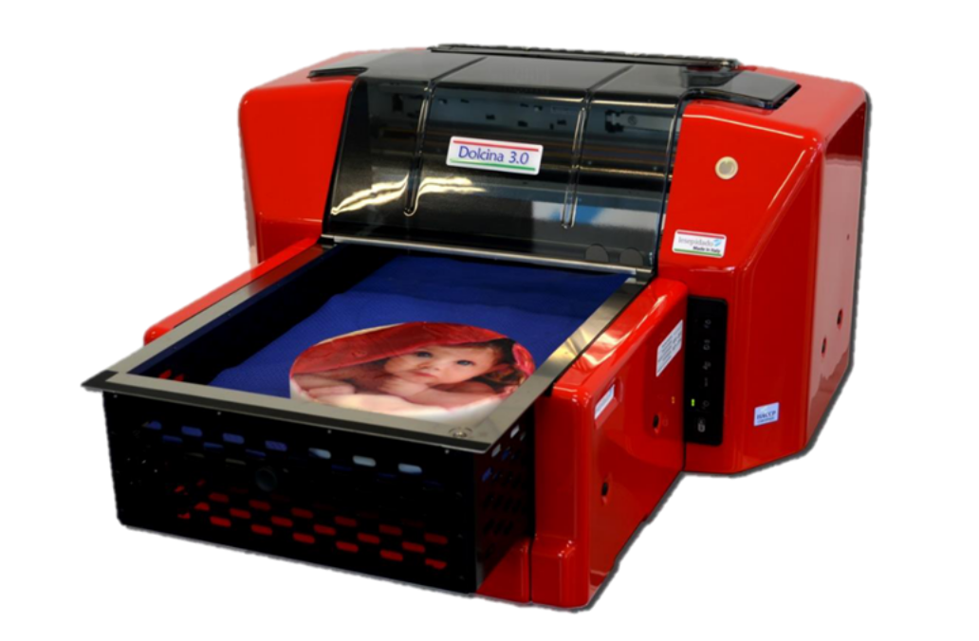
DolciNa3.0
Printing Material: | Cakes, Macarons,Biscuits etc…
Printing Method: | Direct printing on cakes, macarons, etc…
Edible Ink Colors: | 6colors (refillable in 100ml cartridge) Cyan, Magenta, Yellow, Black, Light Cyan, Light Magenta
Ink Usage: | Average 10 ml per SQ.Meter
MAX. Printing Area Per Liter of ink: | 100 SQ. Meter
Printing time at 720x720dpi: | 3 minutes
MAX. Printing Resolution: | 720/1440/2880 dpi
MAX. Printing size: | 315(W) x 510(L) mm
MAX. Weight in Tray: | 4kg
Height Adjustment: | 110mm MAX by Manual
Operating Temperature: | 18-25℃
Operating Humidity: | 35-65%RH
Net/Gross weight: | 25kg
Printer Dimension: | 635x870x373mm
Power Requirements: | 100-240V
Operation System: | Windows 7/10, Macintosh
Printer Connection Interface: | USB2.0
Software: | Driver CD
Country of Origin: | Italy
Dolcina 3.0 is a A3 format (315x510mm) alimentary food printer which can print directly onto confectionary products with a maximum thickness of 11cm such as chocolate, cakes, sugar pastry, biscuits and much more.
It works with 6 cartridges that enable photographic print quality. Compact, convenient and versatile: designed to print easily and low cost.

