Slide 1
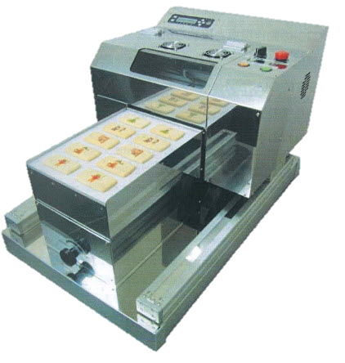
NE-200H
MAX. Printing Size | (W)200 ㎜×(L)287 ㎜
Height Adjustment | 90 ㎜ MAX by Manual
Tray size | (W)210 ㎜×(L)297 ㎜
MAX. Printing Resolution | 600x600dpi, 1200x1200dpi
Edible Ink Colors | 4colors (Cartridge type)CYMK
Support Ink | Eatable nature ink, FD ink, NK ink
Print head | Serial head
Operation System | Control by draft software
Interface | USB2.0
Image type | bitmap、jpeg
Printer Dimension | Min. (W)462mm×(D)726mm×(H)462mm Max. (W)462mm×(D)826mm×(H)462mm
Net/ Gross weight | 38kg
Power Requirements | AC220V-240V
Power usage | Printing Mode 50W, Standby 10W
Temperature environment | Temperature 10-30℃, Humidity 20-80%
Production Scerario(5% each color on A4 manufacturing)
End Product | 4cmX4cm biscuit
Quantity per ink set | 175415pcs | (4color ink set)
Ink cost per pcs of coffee | $0.012 | (Ink set cost /175415pcs biscuit)
Hourly productivity | 120pages | (1page 30sec/time)
A4 by Each color 5% for origin | 4500page | (4color)
Print example | Print per page
Macaron(Ø40mm) | 30
Biscuit(45mmx45mm) | 24
Biscuit(Ø30mm) | 54
Wafer(22mmx70mm) | 39
Wafer L (28mmx93mm) | 20
Wafer S (36mmx36mm) | 64
Cake (100mmx99mm) | 6

Slide 2
Printing Machine USE FOR
We would propose Food printing machine use for the following purpose.
Café promotion.
Decoration on your product.
Optional for Event function or wedding party.
Advertising campaign.
Creative product such souvenir gift, macaron, marshmallow, biscuit, cake etc…

